Slide 1
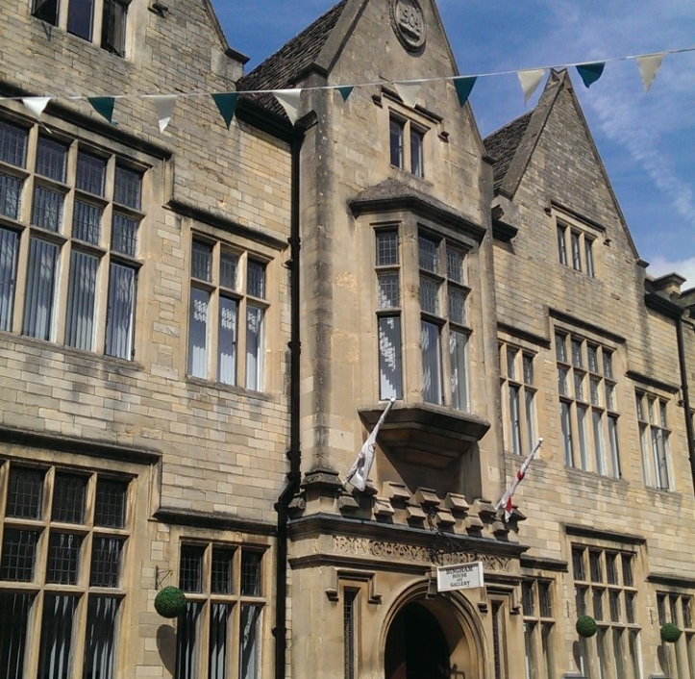
Treasures from the Collections
An exhibition to celebrate the art and heritage of the Bingham Library Trust

Slide 2
“to establish a place for study, for recreation and for reasonable amusement … a permanent resource for the student desirous of supplementing his education and a pleasant refuge for the ordinary reader”
Daniel George Bingham pursued this vision by purchasing 1 Dyer Street in 1903. The foundation stone was laid in January 1904 and the library opened in September 1905.
The library included a ground floor news and reading room, a 200-seat lecture theatre on the first floor and both reference and lending libraries on the top floor.
When Bingham died in 1913, he had the foresight to leave provision for his library. However, by the 1960s, libraries became the responsibility of Gloucestershire County Council. Whilst the premises in Dyer Street was initially retained, increased demand led to the building of a new library which opened in 1975.
Despite this, Bingham’s vision lives on in the work of the Bingham Library Trust and in its preservation of Cirencester’s rich heritage. This exhibition celebrates that heritage through its art and archives which are here today because of Bingham’s legacy.
Daniel George Bingham
by Jan Veth (1864–1925)

Slide 3
“One of the most enthusiastic men he had ever met”
Such was Sidney Harrison described in 1910. The previous year he had been appointed as the Bingham Public Librarian. It is clear he shared Bingham’s vision in both the promotion and preservation of art and heritage and had similar forethought.
“What I'm aiming at is to see in the library every book, print, political squib, map, report, catalogue, newspaper, and periodical issued from a printing press in Cirencester, every book written by a Ciceter man or woman, and every book containing reference to this grand old town … you will have a local collection more interesting than in many a larger town”
From these ideas the Bingham Archive grew. Today it contains nearly 6000 items and includes ephemera, photographs, drawings, records of clubs, societies and businesses, deeds, maps and plans, all relating to Cirencester and the local area. In 2007 the collection was deposited at Gloucestershire Archives in order that it would be preserved in the best archival conditions whilst remaining fully accessible to the public. We encourage you to use and enjoy your Archive
D10820/I-1/am-Part of an apprenticeship indenture from the collection, 1781

Slide 4
Dreaming of “a fine art gallery”
At the time of his death in 1913, Bingham had yet to fulfill his dream of opening a gallery in Cirencester. However, in 1912, the sons and daughter of the artist John Beecham presented Bingham with five of their late father’s paintings to hang in the reading room. It was in a letter thanking the Beecham family that he shared his dream of a gallery.
In the century after the library opened, many works of art were presented to, or acquired by, the Bingham Library Trust. However, there was limited scope to display these works.
In 2005, in honour of the library’s centenary, the original Reading Room was refurbished and reborn as a gallery. Key paintings, including works by Beecham, remain on permanent display in the gallery and elsewhere in Bingham House.
Whilst the Trust is proud to have almost 200 artworks, it is not possible for them to be all on permanent display. However annual thematic exhibitions allow a regularly changing display.
When not in use the paintings are kept within the dedicated stores as pictured and, under normal circumstances, tours can be arranged.

Slide 5
The Beecham paintings were where the art collection began, and they remain at the heart of the Bingham collection.
They have the dual significance of being important works of a renowned Cirencester artist as well as being depictions of key historic events.
John Beecham moved from London to Cirencester, his mother’s hometown, on his father’s death. He was employed by his relative, James Miles, a local plumber and glazier. However, his passion was for painting like his father before him and he also achieved success as an artist.
To the right is a detail from one of the history paintings for which Beecham was most famous.
It depicts the Surrender of Cirencester Abbey by Abbot Blake to the Commissioners of Henry VIII in December 1539.
The Surrender of Cirencester Abbey by John Beecham,
19th century

Slide 6
In this painting Beecham depicts Cirencester during the Civil War.
As Parliamentarians dominated in Cirencester, the attempt by Lord Chandos and his Commission to recruit men for the Kings army was inevitably met with great hostility.
The picture depicts the market place before the 1830 demolition of the Shambles and is therefore of additional architectural interest.
The Attack on Lord Chandos' Coach of August 1642 by John Beecham, 19th century

Slide 7
Edward II spending Christmas at Cirencester in 1321 by John Beecham, 19th century
The painting depicts the King, Queen Isabella and the Prince of Wales, alongside various nobles, at a banquet in St John’s Hospital. As the party are entertained more dishes fit for Royalty, including a boar’s head and a dressed peacock, are being brought in.

Slide 8
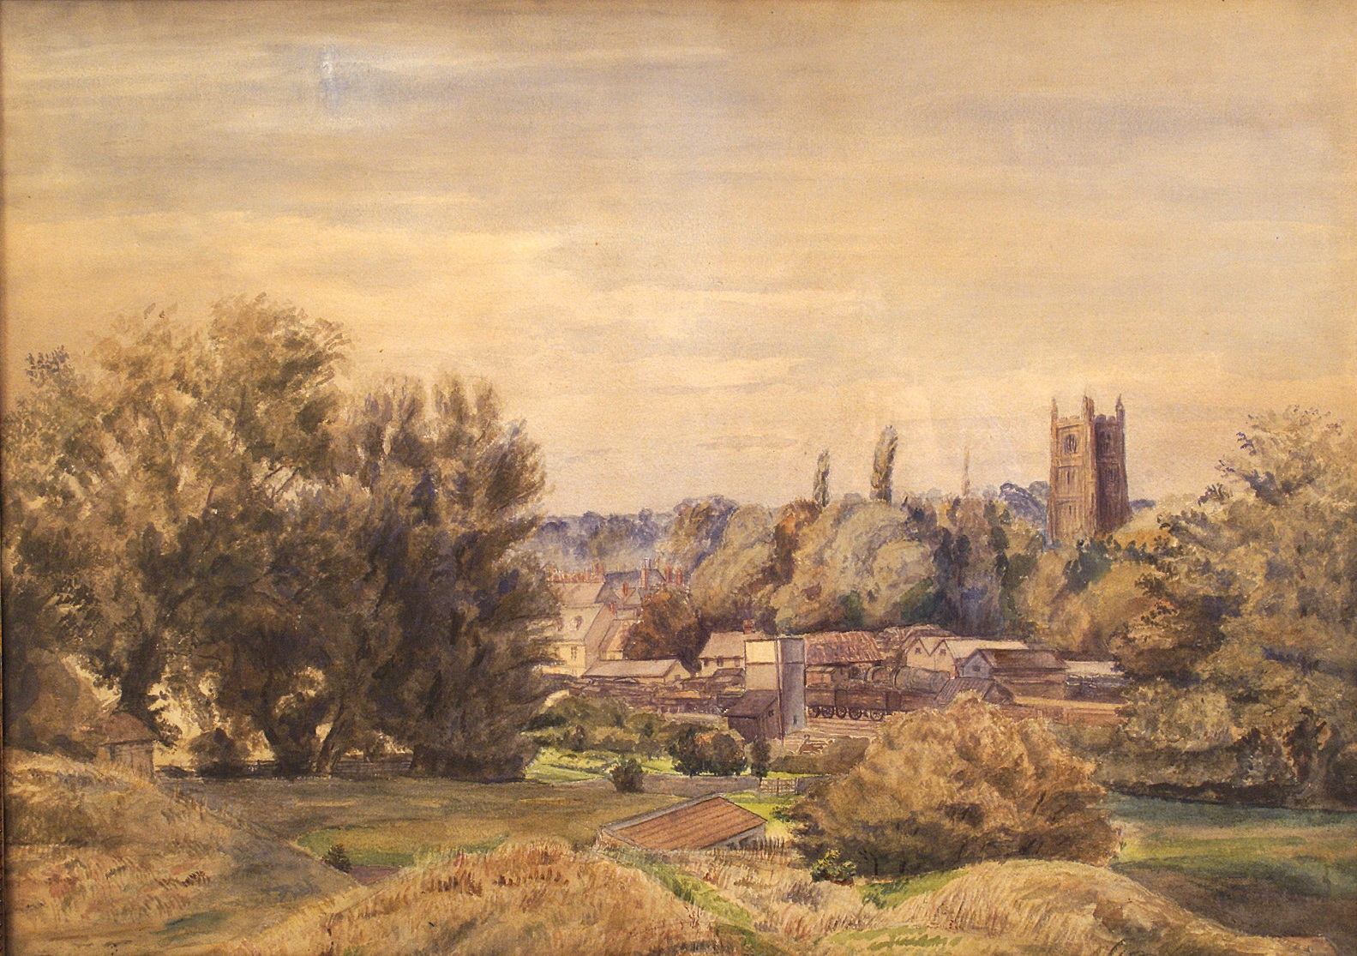
Edward, Owen and Francis (Frank) Gibbons were three brothers, all of whom studied at the Cirencester School of Art in the 1860s and 1870s. Both Edward and Frank remained in Cirencester. Examples of works by Edward and Frank are seen here.
Above is Frank Gibbons' 1914 watercolour of
Shepherd's Place with its archway dated 1649.
To the left is Edward Gibbons' 1880 depiction of Cirencester Station from the Querns.

Slide 9
Hampshire born Victor Coverley-Price showed artistic promise at an early age. Before he had completed his degree at Cambridge, he had had two paintings exhibited at the Royal Academy.
After completing his degree, he joined the Diplomatic Service. This exposure to many different countries and scenery greatly inspired his art. A newspaper report of the period gives an account of his time painting in Egypt.
Following the Second World War he retired and turned solely to painting and writing.
Coverley Price moved to Cirencester in 1965. The town and surrounding area inspired him further.
This painting is particularly special for its dual representation of the beauty of Cirencester’s architecture and of its social history.
Cirencester Market Place c.1965 Victor Coverley Price

Slide 10
Coverley Price’s painting of Cirencester Parish church as viewed from the Abbey grounds, 1969

Slide 11
Within the art collection there is an array of different styles and mediums.
One of the earliest works, circa 1790, is an unfinished sketch created in graphite and brown ink by Joseph Farington.
The Lancashire born Farington was famous for his landscape painting and topographical sketches as well as for being a renowned diarist.
That a work remains unfinished does not detract from its value. Instead such works give insight into the artist’s creative process and techniques.
Cirencester Church and Market Place, Joseph Farington, circa 1790

Slide 12
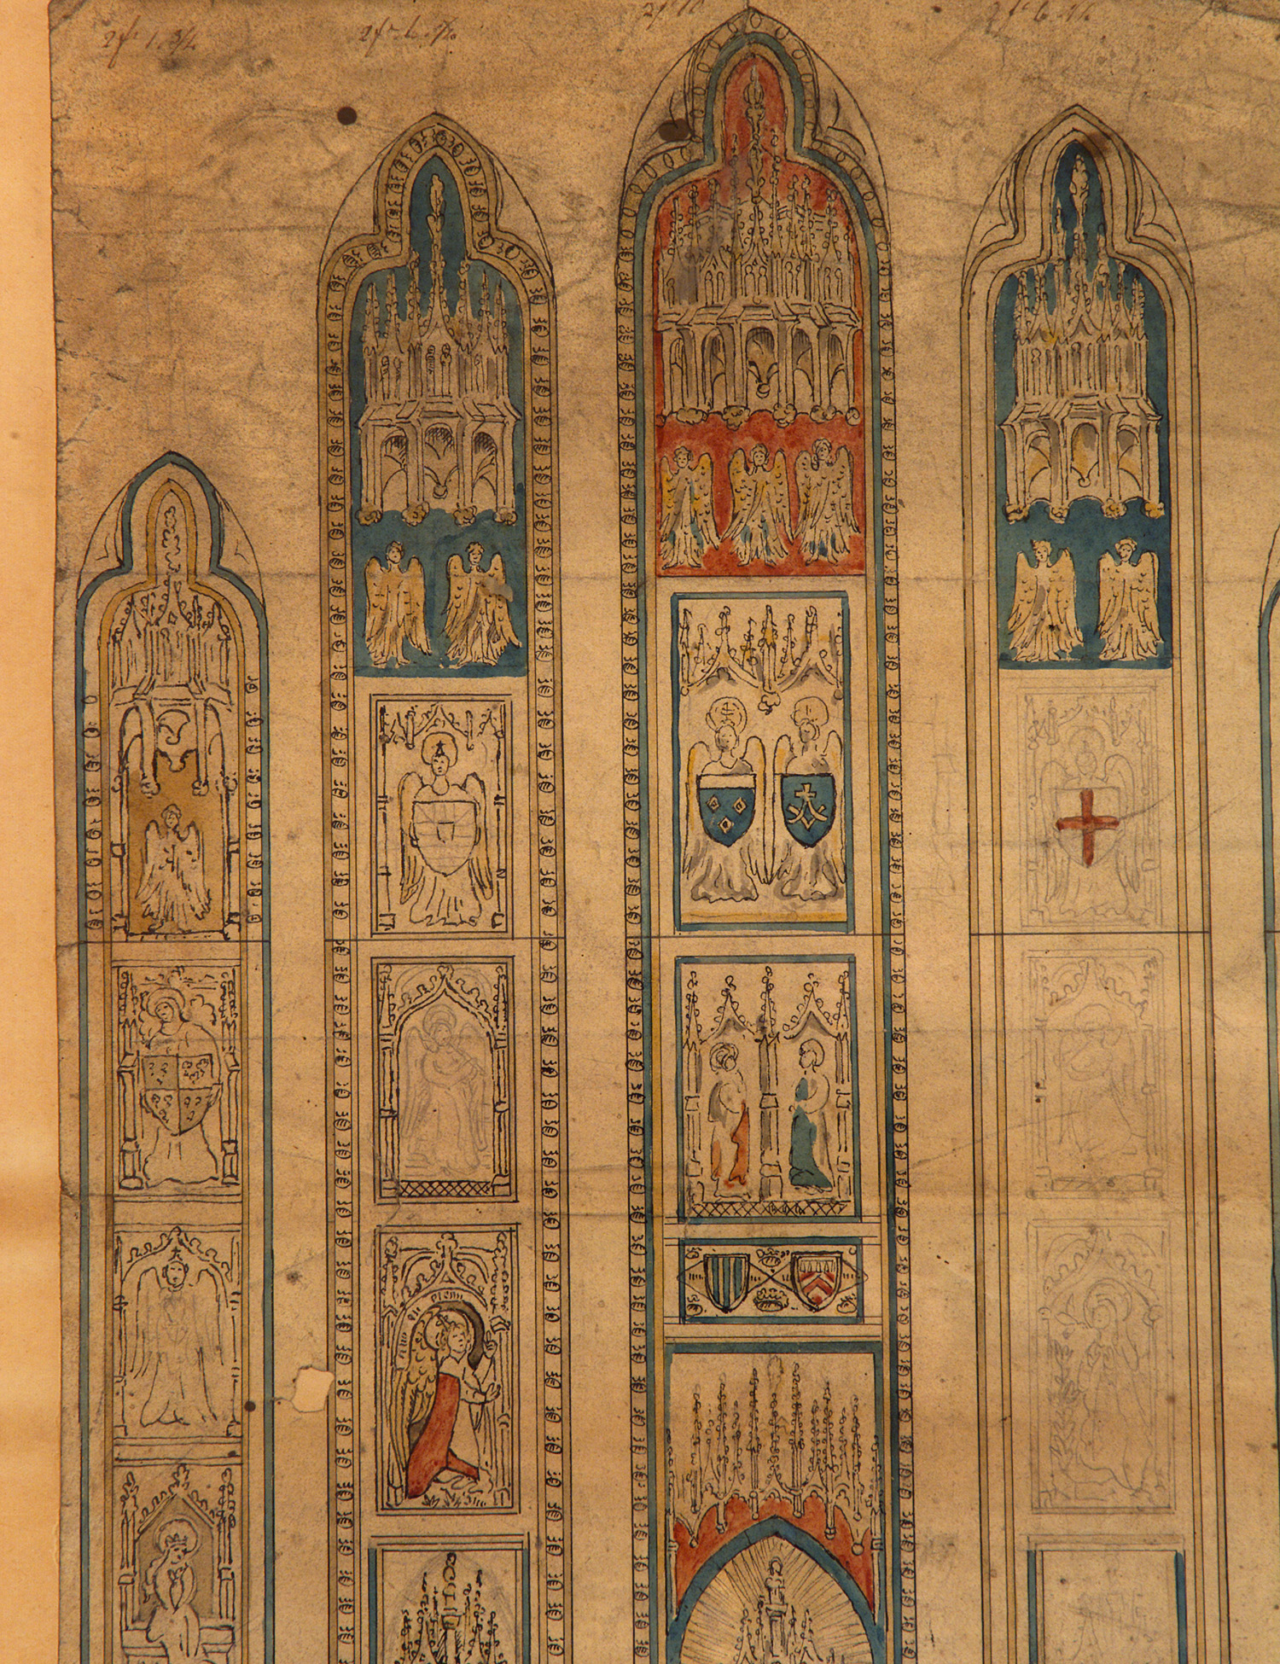
This sketch of 1799 is Samuel Lysons’ design for the Chancel Window in Cirencester Church.
By this date, the fragmented state of the medieval glass was such that Lysons proposed reassembling it in the east and west windows.
The sketch records Lysons’ chosen arrangement. The work was to be carried out by the glazier James Miles, relation of John Beecham.
The design was created in ink, watercolour and graphite.

Slide 13
Within the collection are artworks which commemorate contemporary local events and thus have the additional value of being historic records.
This painting by A Krause depicts the visit of Queen Elizabeth II to review a Passing Out Parade at RAF South Cerney; on 20th April 1961.
It was presented to the Bingham Library Trust by Group Captain T.C. Musgrave OBE DFC the following year.

Slide 14
Local artist Laurie Plant was commissioned to produce a painting celebrating Cirencester and Bingham’s legacy.
Plant’s work was two years in the making. It was completed and first displayed in 2013.
This iconic painting reflects Bingham’s influence as well as telling Cirencester’s story from industry to agriculture and of people and places.
It is a key example of how the Bingham Library Trust aspires to preserve Cirencester’s heritage, whilst ensuring the art collection grows and that contemporary art is also represented.
Cirencester - The Capital of the Cotswolds by Laurie Plant, 2013

Slide 15
2017 marked the 900th anniversary of King Henry VIII’s founding of the Augustinian Abbey of St Mary in Cirencester.
A commemorative painting was commissioned from local artist, Tracey Elphick.
This wonderful mixed media piece depicts various images that are symbolic to the history of the Abbey.
Following the anniversary celebrations and events the Patron, Bishop Rachel Treweek, presented it to the Bingham Library Trust.
The Trust is honoured to have this important, commemorative piece as part of the collection.

Slide 16
This depiction of a festive Cirencester Market is by the artist Nelson Rooke and was painted in 1953.
This is the final painting in the exhibition and, most appropriately, is the Bingham Library Trust’s very latest acquisition.
It remains the Trust’s aim to keep adding to the collection in order to continue to preserve and share the art of the Cirencester area and of Cirencester artists.
The public have a vital role to play in this, both through making donations of artworks and by sharing any knowledge of opportunities for the Trust to acquire suitable artworks.
Cirencester Market at Christmas by Nelson Rooke, 1953

Slide 17
Within the art collection there are extensive engravings, prints and photographs.
This example is a detailed and accurate depiction of 19th century Cirencester as well as a visual account of a key archaeological event and evidence of Roman Cirencester.
The discovery of several mosaics was quite by chance, whilst workmen were digging drains.
This illustration was taken from the Illustrated London News, but the discovery was of such importance as to be recorded in various national and local newspapers as well as those from other districts, including the Salisbury and Winchester Journal.
The two mosaics that were successfully excavated remain in the Corinium museum today.

Slide 18
This 1913 photograph depicts the Abbey house, lake and grounds.
Across the lake workers from the estate can be seen gathering in the hay.
At this time the property was owned and occupied by the Masters family but in 1965 it was sadly demolished and the grounds became the public park that remains to this day.
The talented photographer is John Henry Thomas. He lived in London but was a frequent visitor to the Cirencester area and took many wonderful photographs.

Slide 19
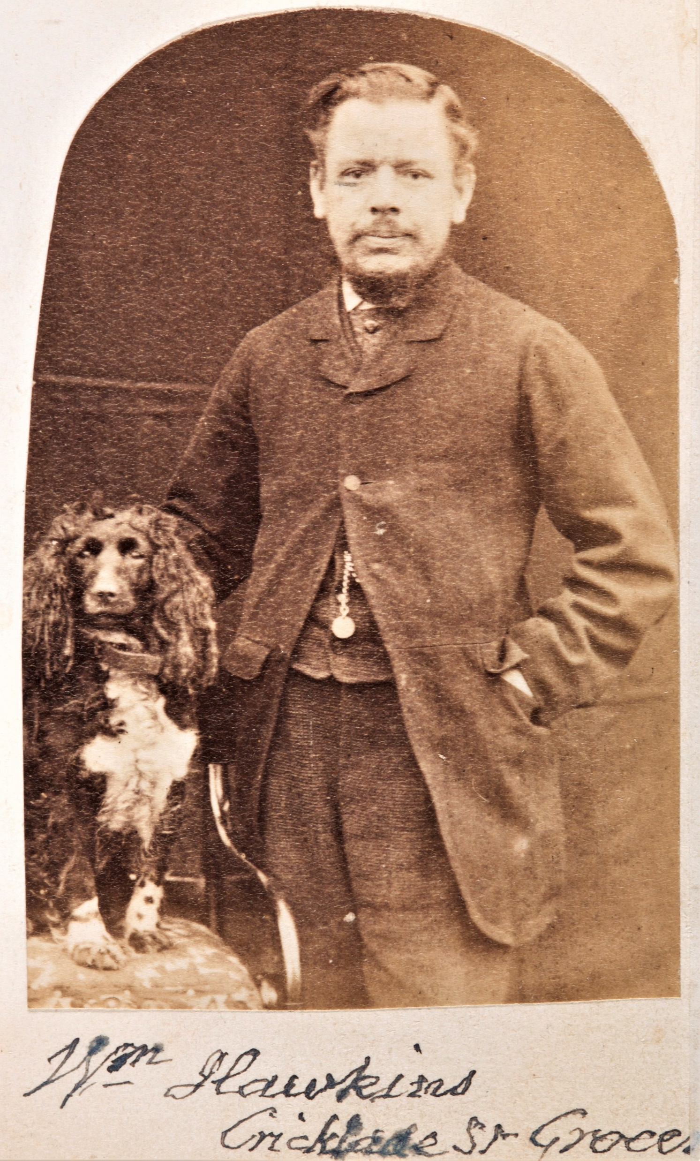
With glass negatives first introduced in 1839, photography was still in its infancy when Thomas Cox took these photographs. They mostly date from the 1860s.
A solicitors managing clerk, he was very active in the community and was the stepfather of Daniel George Bingham.
His photographs capture people (and animals) from all different backgrounds, providing a rich resource on 19th century society in Cirencester
Stroud born grocer, William Hawkins, of Cricklade Street alongside his dog
This is a wonderful portrait of John Beecham. Without Cox’s passion for photography we may not have had a likeness of the artist whose works could be said to have set the Bingham art gallery in motion.

Slide 20
Gloucestershire’s Archival Heritage
Most of the archives that follow are from the Bingham Library Trust Archive, reference D10820.
However, Gloucestershire Archives is home to material relating to people and places throughout the historic county of Gloucestershire. All of these archives are accessible to all.
These examples are intended to demonstrate the variety of archives that have been collected and the value of different material.
Through written records, drawings, photographs and ephemera, stories are revealed that may otherwise have been lost to history.
Below is just a glimpse of the catalogue for the Bingham Library Trust Archive. Further information about using the catalogue and accessing the archives is available on our website and by emailing the Trust directly.
Even within this short extract, there is an array of different items dating from the late 18th century to the late 20th century. It reiterates that the most diverse of archives may be found in a person’s private possession. All archives have historic value and could become welcome additions to the collection.

Slide 21
The colours of this poster are as bright as when first painted. With the archival collection in the care of Gloucestershire Archives its continued preservation is guaranteed.
Miss A.M Buckton’s Eager Heart was first performed at the Lincolns Inn Theatre in 1904 and described as a tender story of the humble maiden, Eager Heart, who made ready her simple dwelling for the Christ Child, believing the legend that on Christmas Eve He would seek her roof to cover Him
It was performed at the Bingham Hall in January 1912. The Wiltshire and Gloucestershire Standard described it as strikingly beautiful and impressive.
The Hall was completed and opened in October 1908. Bingham created the substantial hall with a fixed stage and retiring room for performances and meetings. In addition, there was a rifle range so that boys of Cirencester would have an opportunity for healthful and wholesome pursuits and recreation.
There was a ceremony for the laying of the foundation stone in March 1908 and the grand opening that October was presided over by the Earl of Bathurst.
D10820/E1-2/c - Poster for "Eager heart", a Christmas mystery play, 1912

Slide 22
This is a detail of a map of Cirencester that was both drawn and annotated by Kennett J Beecham, the son of John Beecham, the artist.
Beecham was an architect and surveyor by trade as well as the author of a History of Cirencester which was published in 1887.
The map is annotated to show sites of modern Cirencester alongside historical features and details of key archaeological discoveries. The particular focus is on the known features of Roman Corinium.
D10820/Maps/1/5 - Map of Cirencester, drawn and annotated by Kennett J Beecham, 1910

Slide 23
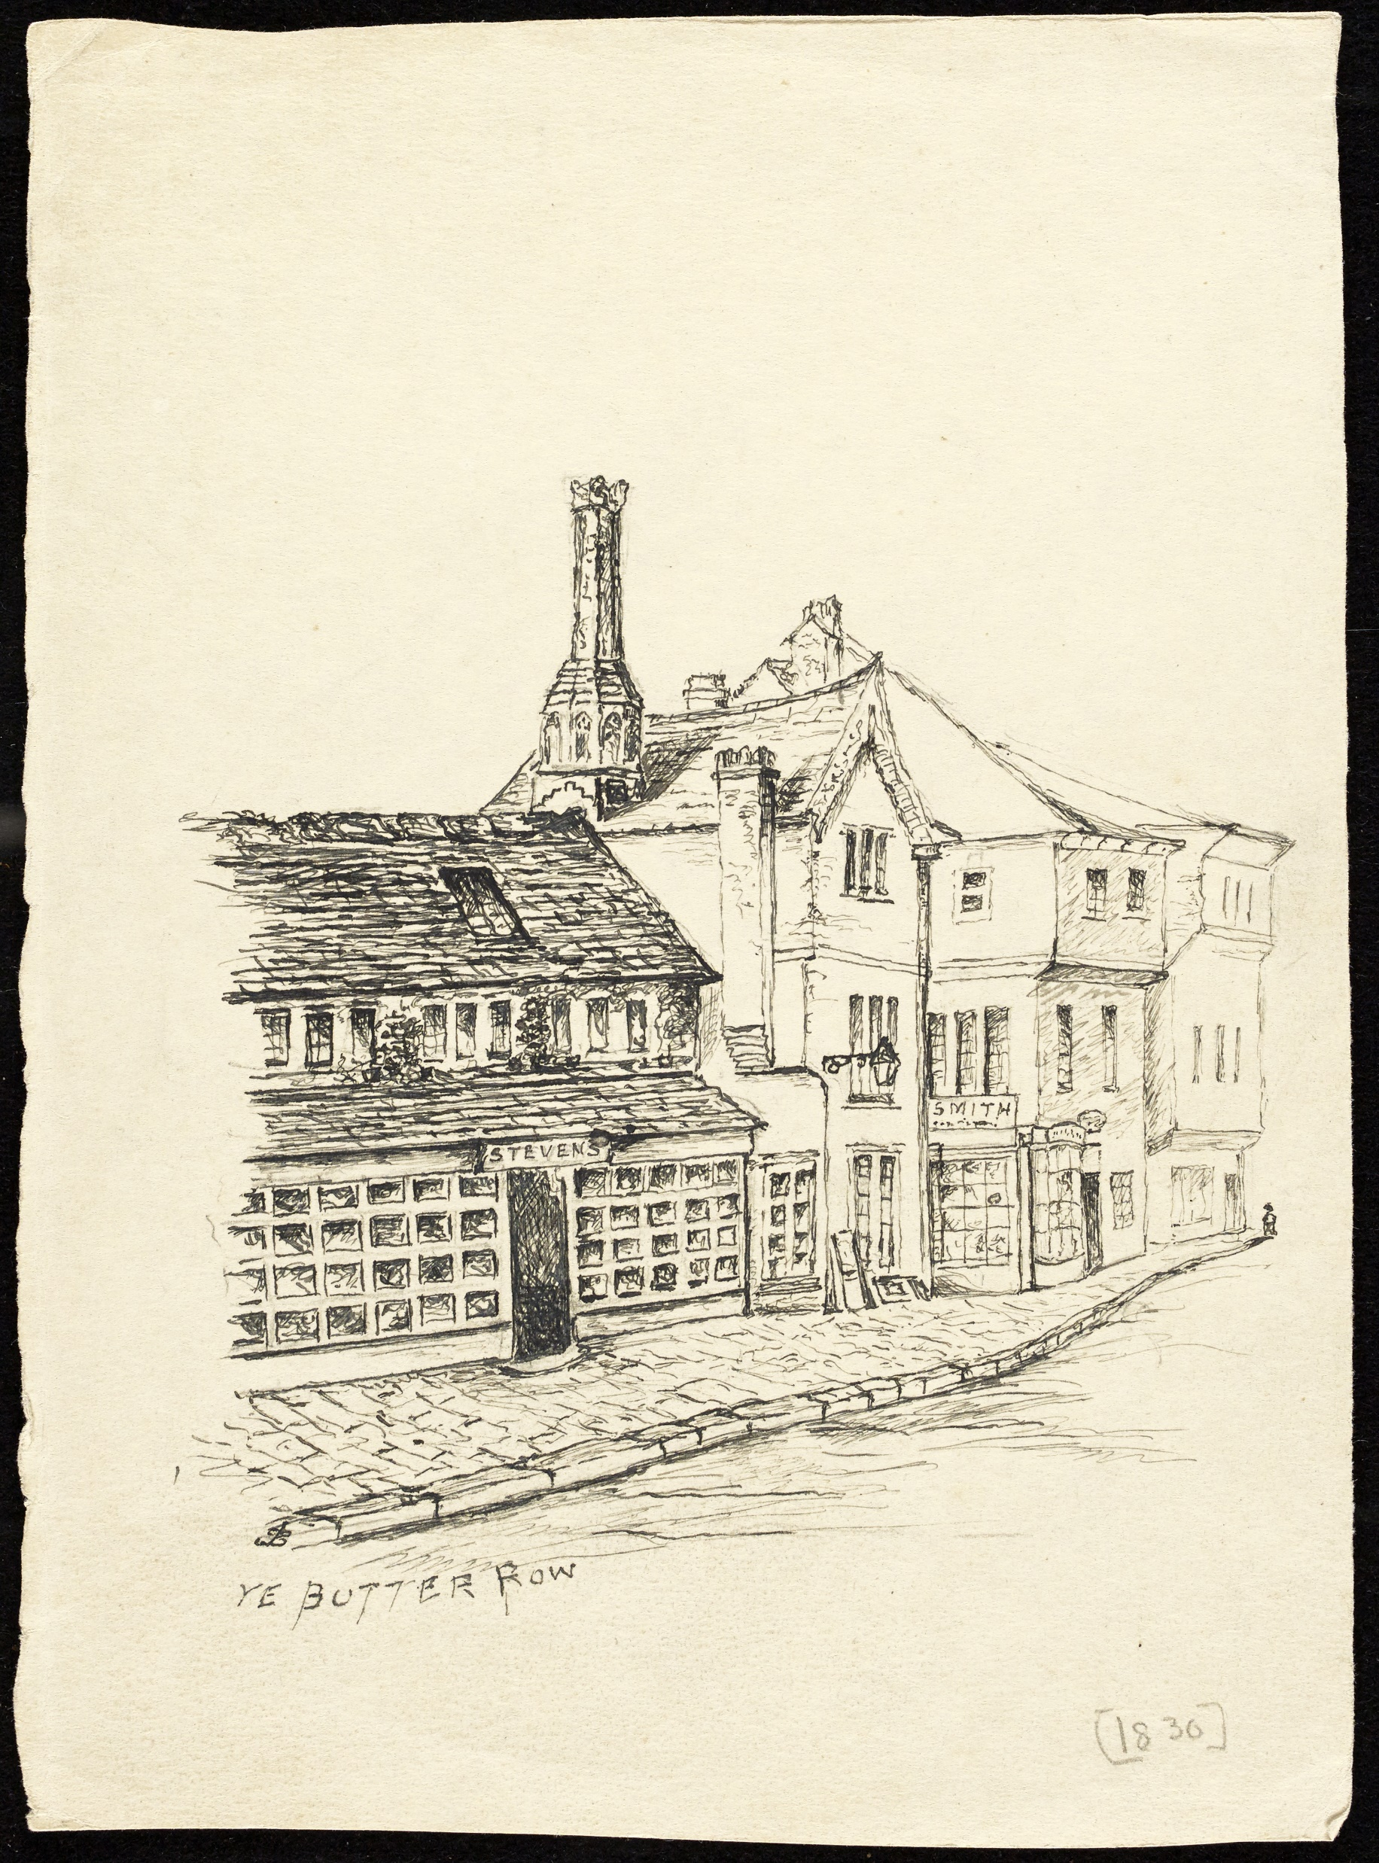
Within the Welsford collection are these images of Butter Row. The postcard reproduction on the left dates from c1900 and the original drawing on the right dates from c1930.
Jean Welsford was an important local historian who catalogued the Bingham Library Trust Archive in the 1980s, when her husband Alan was librarian.
Her work was pivotal in ensuring that, today, the Bingham Archive is so carefully listed and fully accessible to all at Gloucestershire Archives
D10820/WELS/388/MKT/15a
D10820/WELS/388/MKT/38

Slide 24
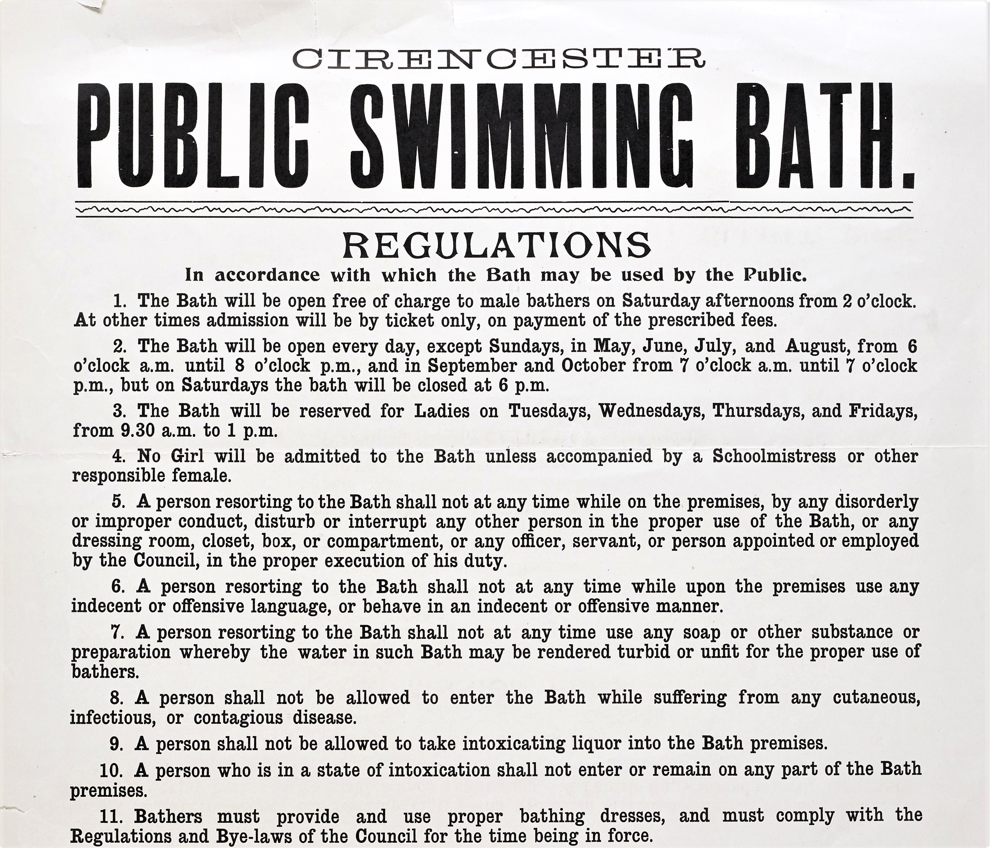
The Cirencester Swimming Bath opened in May 1870. The Wiltshire and Swindon Standard visited two weeks after the opening and declared the town can now boast of possessing as fine a Swimming Bath as any in the kingdom. A visit of the previous Saturday found about 70 youngsters thoroughly enjoying themselves in the water.
Many archives have a greater value than may first appear. This poster is part of the history of the Swimming Baths but it also provides information on Edwardian etiquette and expectations of behaviour, as well as details of contemporary prices.
D10820/Box 143/3/12 - Cirencester public swimming bath poster with regulations and admission fees, 1911

Slide 25
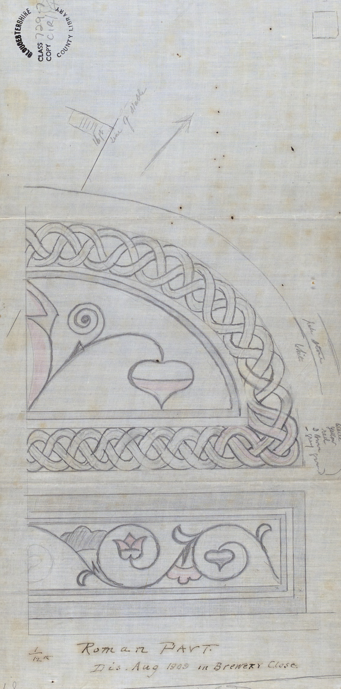
The discovery of the remains of a Roman pavement, as depicted in these drawings, drew many visitors to Cirencester. On 4th September 1909 the Cheltenham Chronicle recorded Now the discovery of Roman remains in the form of a mosaic has been made in the paddock of the Cirencester brewery Co … Workmen were engaged excavating for the putting in of a drain, when, at the depth of four feet, they came upon the edge of a piece of tessellated pavement, and, following its surface, they have succeeded in laying bare a surface some 10 feet by 7 feet, which includes perfect symmetrical ornamental and floral designs in fine colours.
D10820/WELS/729.7/CIR/14-Roman mosaics: drawings of detail in the tessellated pavement found in the Brewery Field in 1909

Slide 26
Hosting a cricket match featuring the All England eleven was a significant event. The small print reveals the extensive security measures put in place by the Bathurst Estate. Accounts of the game appeared in various local newspapers.
The Wiltshire and Gloucestershire Standard reported that the game attracted a vast number of spectators, including many of the aristocracy of the neighbourhood, and not a few sporting celebrities. The band of the North Gloucestershire militia was in attendance and the play was admirable throughout.
The Gloucester Journal concluded the stumps were drawn on Friday evening being Cirencester, with two innings, 211, against All England with one inning, 78, thus leaving the latter in a minority of 133. On Saturday the game was resumed by the All England players going in for their second innings, but the fielding of their opponents was too good for them, and before two o'clock the match terminated in favour of Cirencester, the All England men only making 53 in their final effort .
D10820/A8-1/I – Memorabilia relating to miscellaneous cricket fixtures including All England XI v Cirencester 22, 1864

Slide 27
The Sun Inn, as pictured in Richmond’s drawing, is a half-timbered, gabled building, largely unchanged from its 17th century beginnings.
Without early artwork and/or photographs, visual information about places, property and people is lost forever. The Sun Inn underwent rebuilds in 1868 and in 1913 yet, through artwork and archives, its original façade can be remembered. It was closed in 1922 and became a garage. Today it is part of The Fleece Inn.
The Sun Inn is famous for reputedly sheltering Charles II. An article in the Wiltshire and Swindon Standard from 1912 records Returning to the flight of Charles II and his guides and protectors, at nightfall on September 11, 1651, they entered Cirencester and spent the night at the Sun Inn. Although several of Cirencester’s public houses make the same claim, The Sun Inn is most consistently reported as being the true location.
D10820/WELS/647/SUN/1 -The Sun Inn: pen and ink drawing by William Richmond, 1898

Slide 28
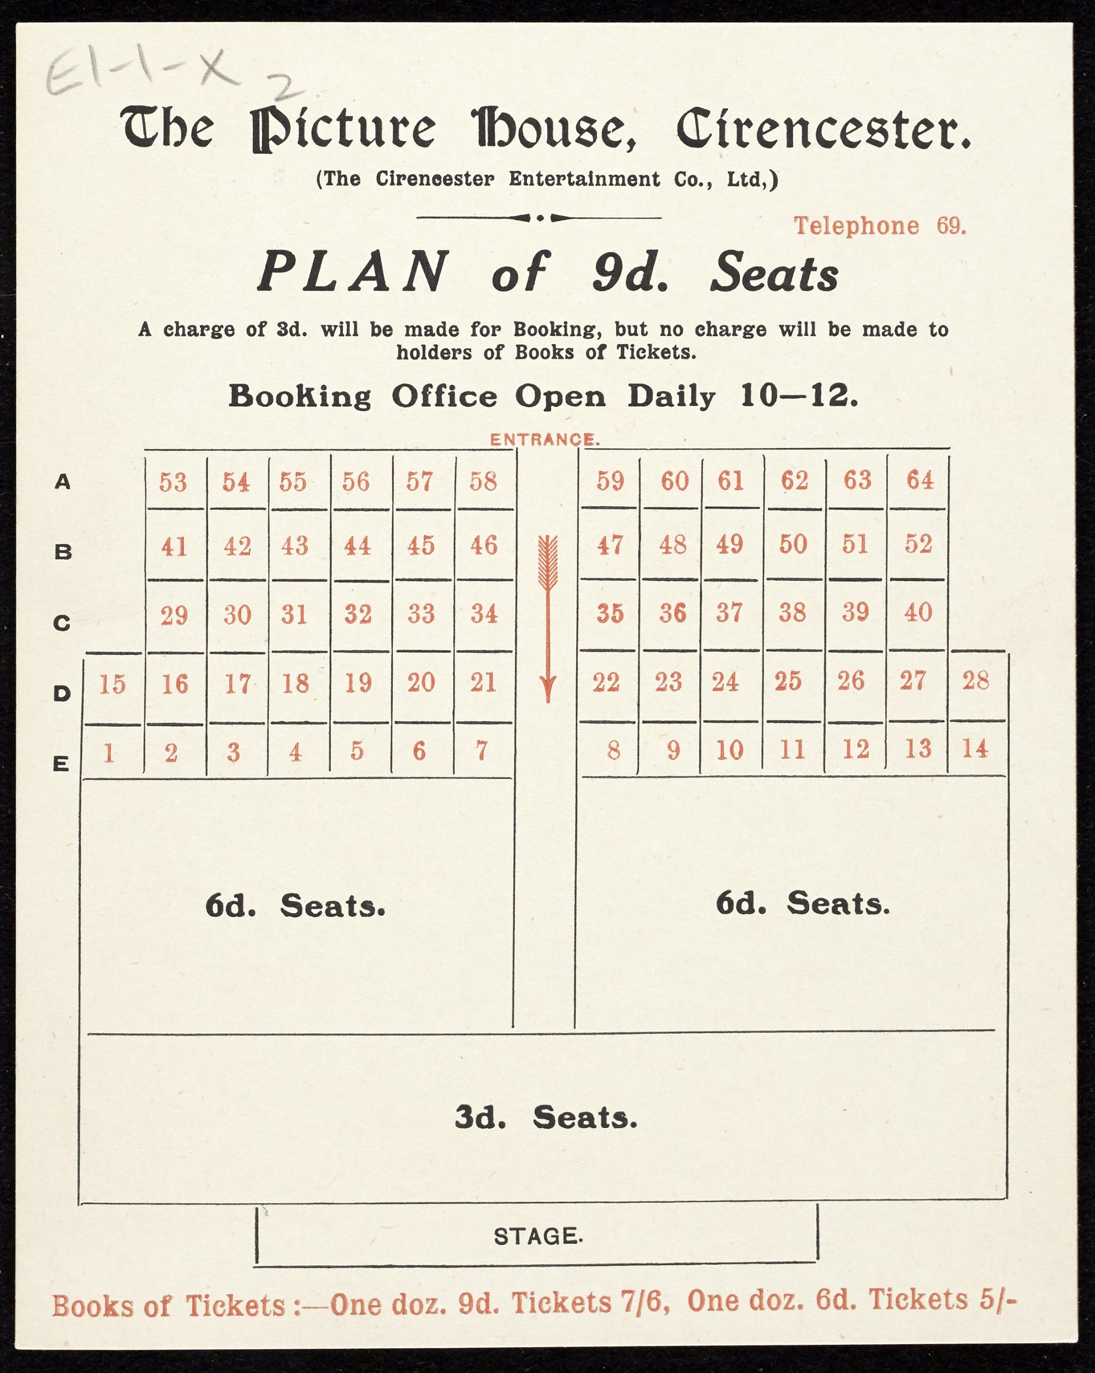
This programme dates from 1913 when the Cirencester Picture House was in its infancy.
There was a substantial programme for its opening week which commenced on Easter Monday.
The cost of tickets varied depending on the location of the seats.
The main features offered during the opening week can be seen on the next slide.
D10820/E1-1/x - The Picture House, programme with seat plan and features

Slide 29
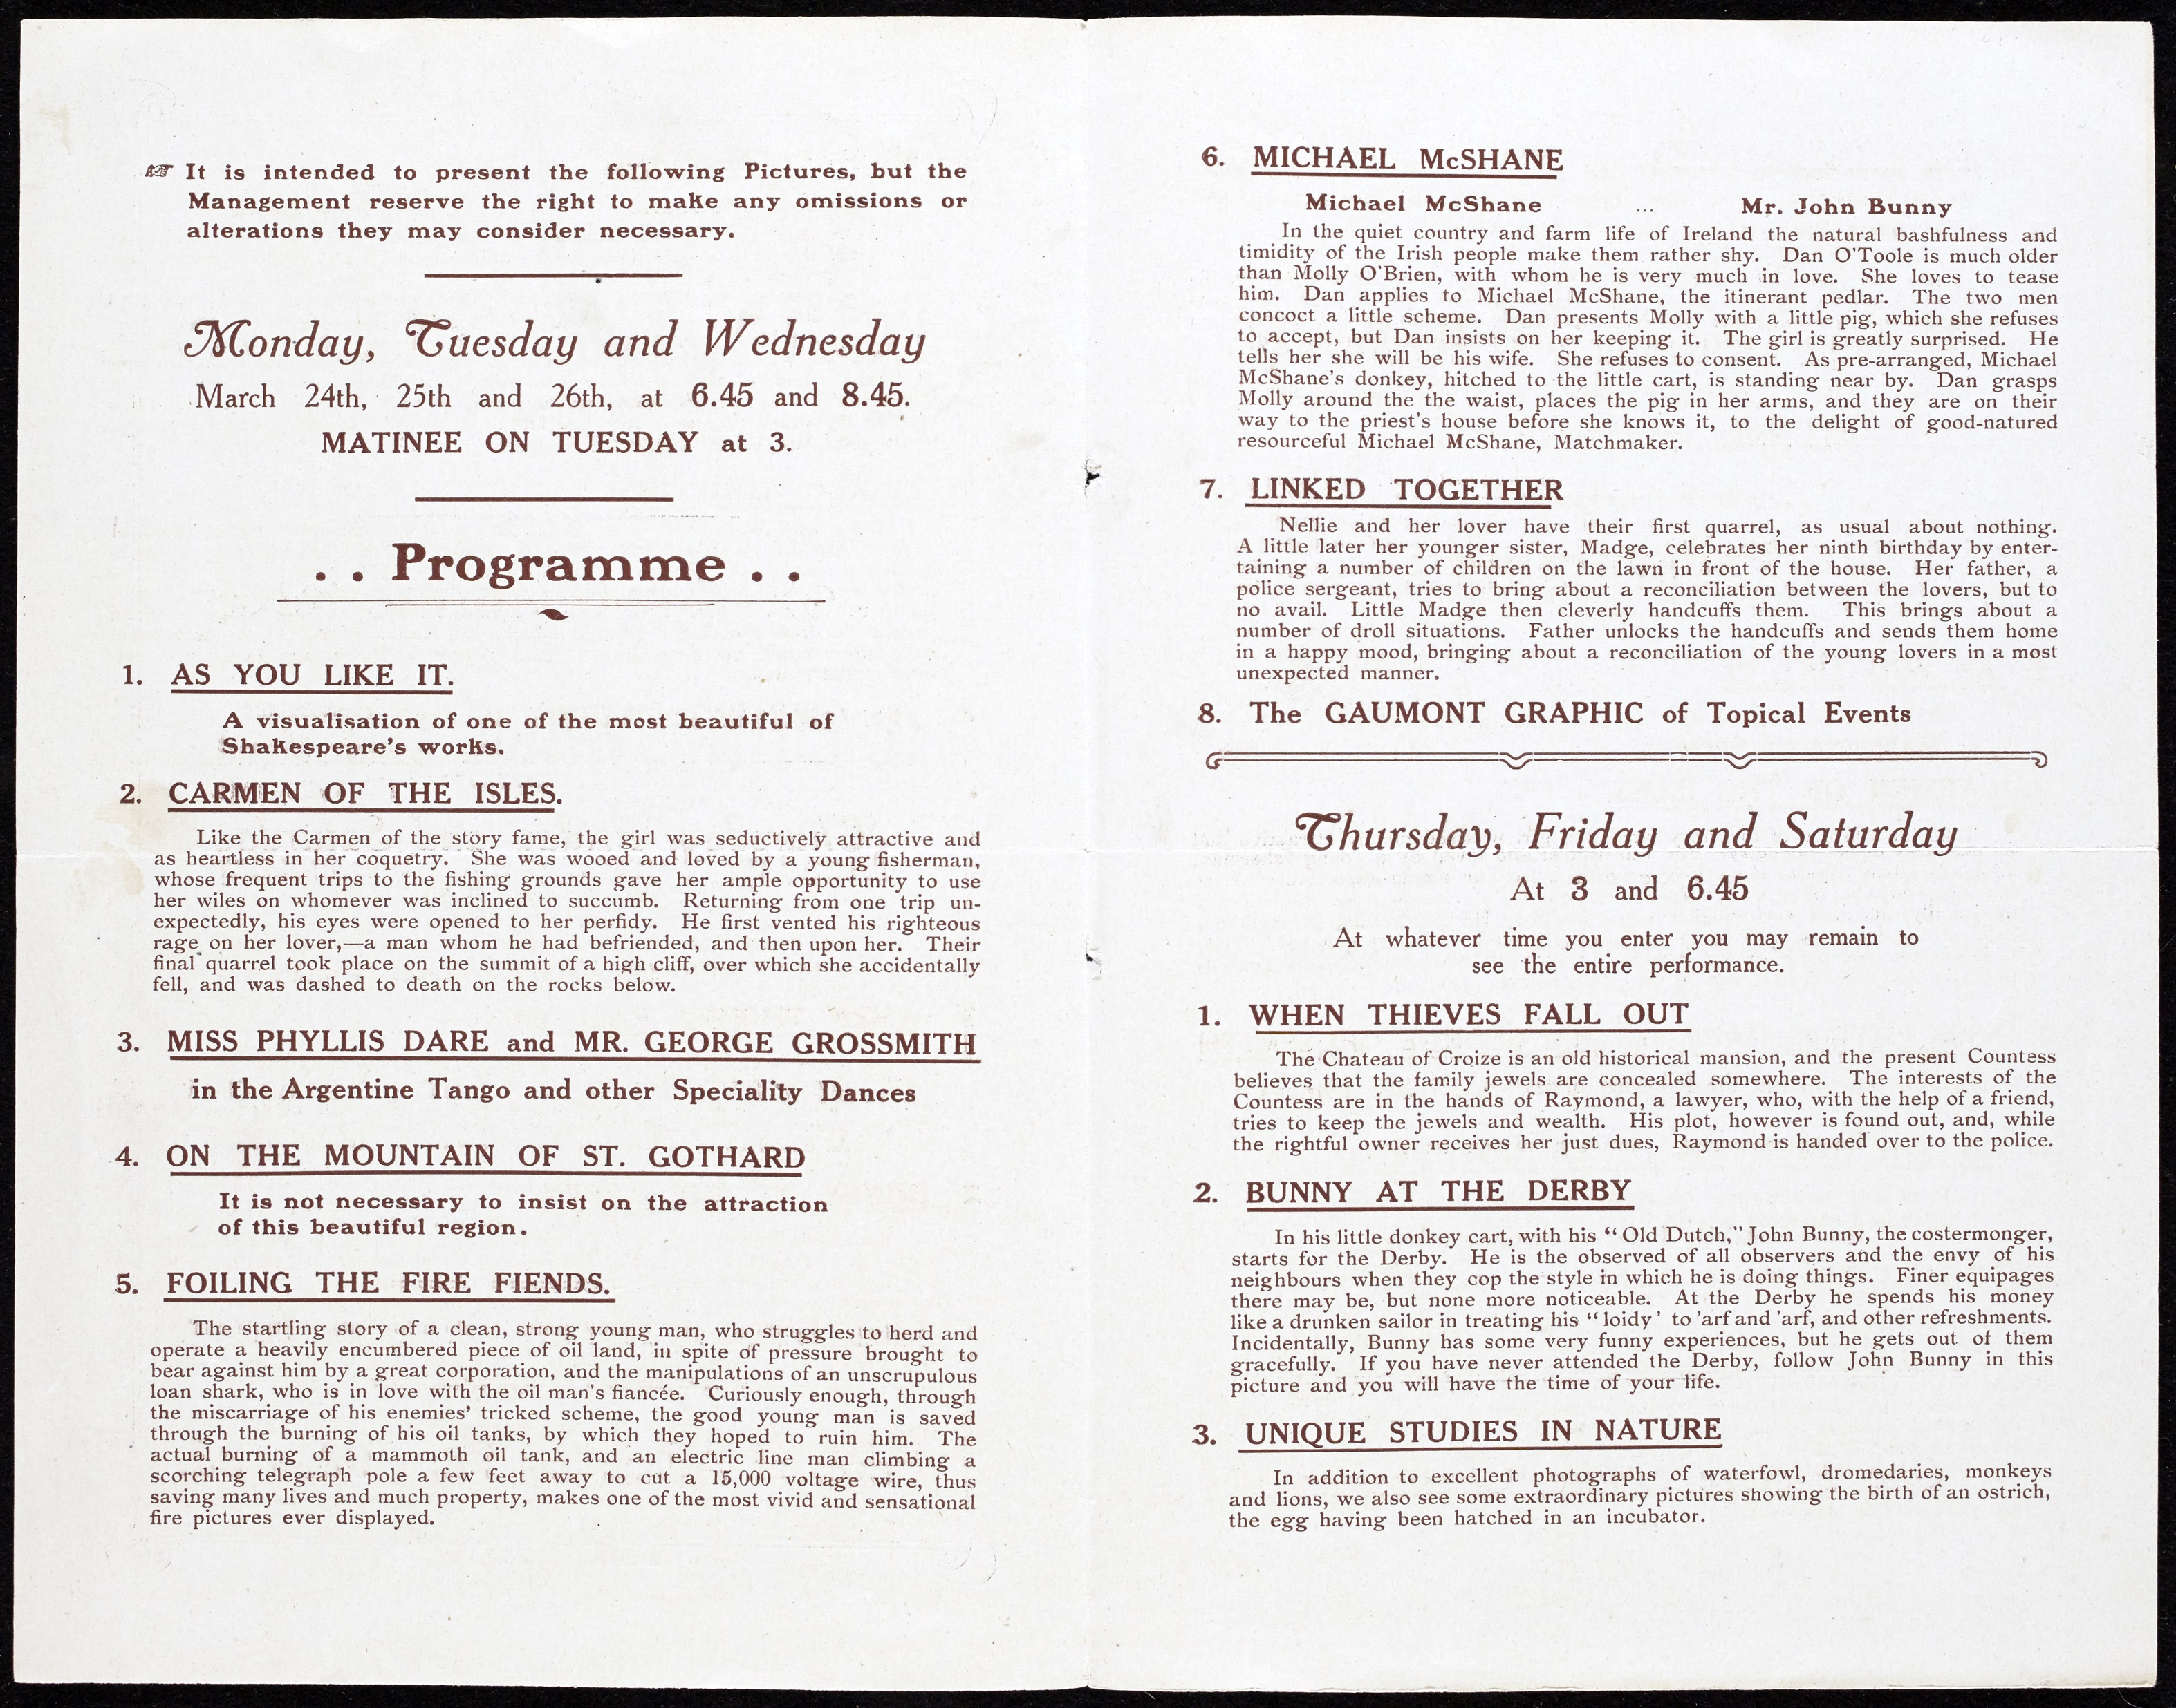

Slide 30
As with many archives, this advert reveals an insignificant event (except for the poor owner) that would have otherwise been long forgotten.
Sometimes archives can raise more questions than they answer. Such as who would have owned such a valuable scarf pin? Was the owner most concerned for its monetary or sentimental value? Was it ever found and returned?
It is also interesting to note the reference to Cirencester Cathedral. In consideration of its size and magnificence, the parish church has often been referred to as the “Cathedral of the Cotswolds”
D10820/L1-1/d - Reward poster for a lost diamond cluster, c1850

Slide 31
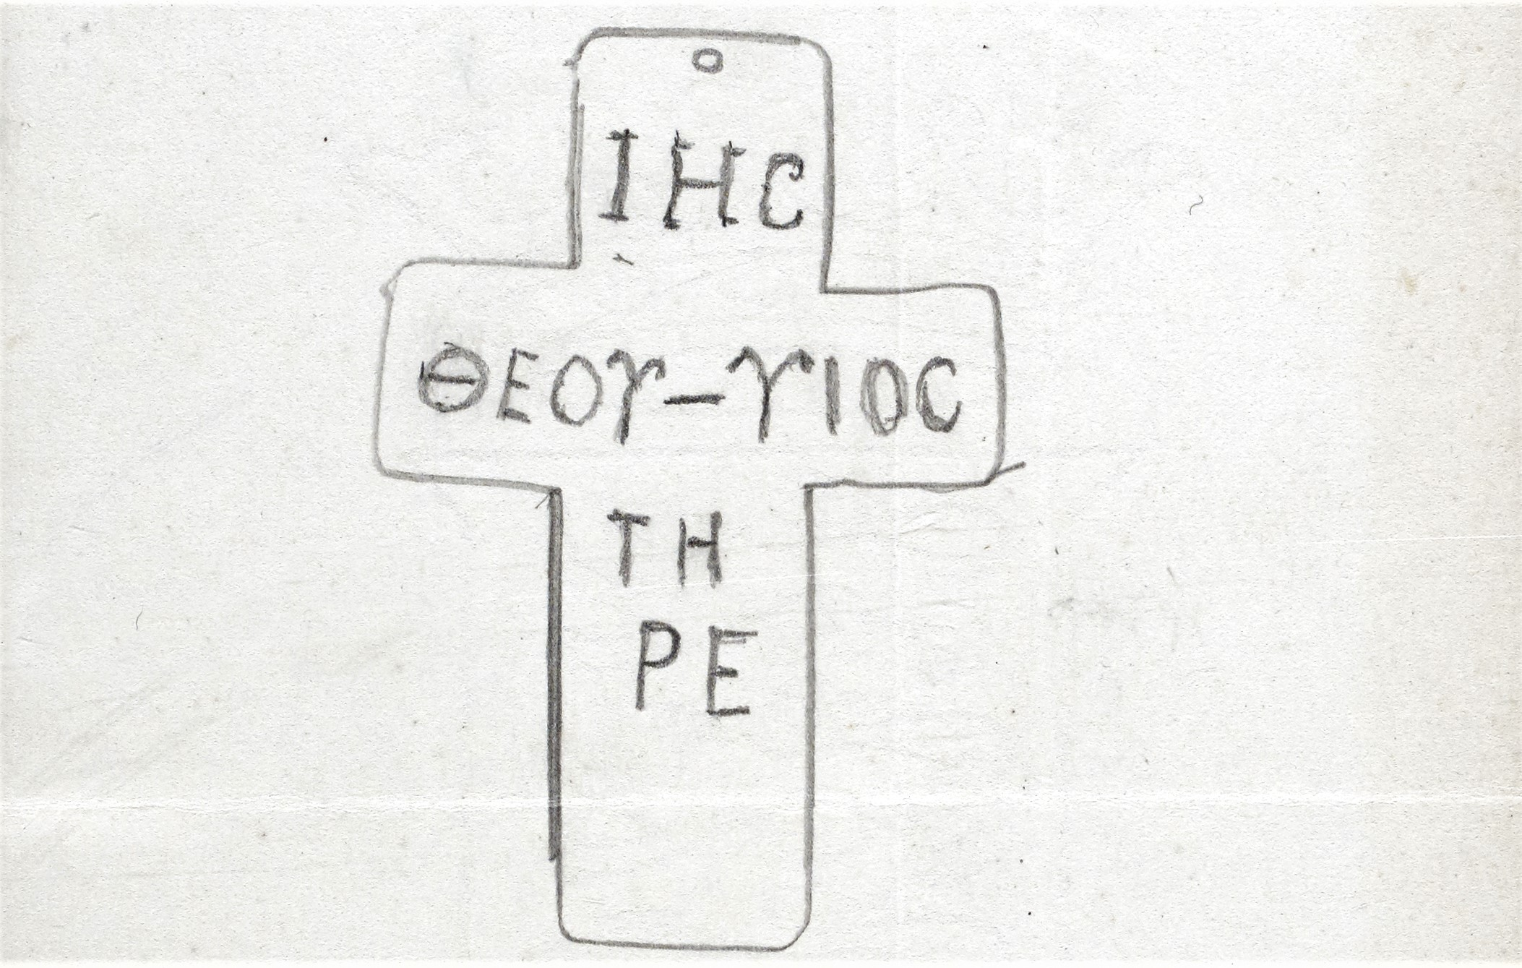
This photograph and sketch are of a silver cross that was discovered in the Abbey Gardens in 1908. Accompanying them are extensive notes and correspondence. These tell the story of the discovery of the cross and of subsequent discussions about the cross itself.
Several experts offered a range of estimated dates for the making of the cross as well as differing opinions regarding the meaning of the text and the purpose of the cross.
D10820/C4-1/g - Photographs, sketch and correspondence relating to a silver cross found in Abbey House Garden, 1908-9

Slide 32
These new buildings, situated on the Northern side of Castle Street, were commissioned by Earl Bathurst and designed by London architect, John Birch. The houses, shops and offices included a new Post Office and grand Municipal offices in the centre.
D10820/WELS/388/CAS/15 - Castle Street sketch by John Birch

Slide 33
The holding of property auctions in public houses was common practice in the 19th century. Public houses were also frequently used for coroner’s inquests, to hold political meetings and even court sessions.
There are references to The Ram Inn, a substantial coaching inn, as early as the mid-16th century.
The advert reveals that the property was being sold by the trustees of the late Mrs Betty Bramble. Often, clues within one document can lead to other documents and to additional information. In this case the clues within the advert suggested further information would be found in Betty’s will. The will, being proved in the Diocese of Gloucester, is held today at Gloucestershire Archives.
At the time of making her will the property remained in the occupation of the surgeon, Mr Bedwell, with the rental income going directly to her trustees. However, once the property was vacant, the trustees were able to put it up for sale.
D10820/P4-6/f - Poster advertising the sale by auction of a freehold dwelling house in Dollar Ward,1827

Slide 34
This poster is a symbol of local support for WWI soldiers and of community spirit in war time.
It is unfortunate that the precise details of the entertainment is unknown, although it appears some of the soldiers were taking part in the entertaining rather than being entertained.
The Temperance Hall on Thomas Street was built in 1846 by Christopher Bowly. Bowly was a Quaker and leader in the Temperance movement and a local philanthropist. It was opened in December 1846. Sadly Bowly died just five years later.
The site of the Hall was previously that of a brewery. The building of a Temperance Hall on a brewery site would have been particularly poignant for Bowly. It is recorded that he met the full cost himself, quoted in the newspapers as approximately £1500.
D10820/Box 143/3/16 - Poster: entertainment for soldiers in the Temperance Hall during WWI

Slide 35
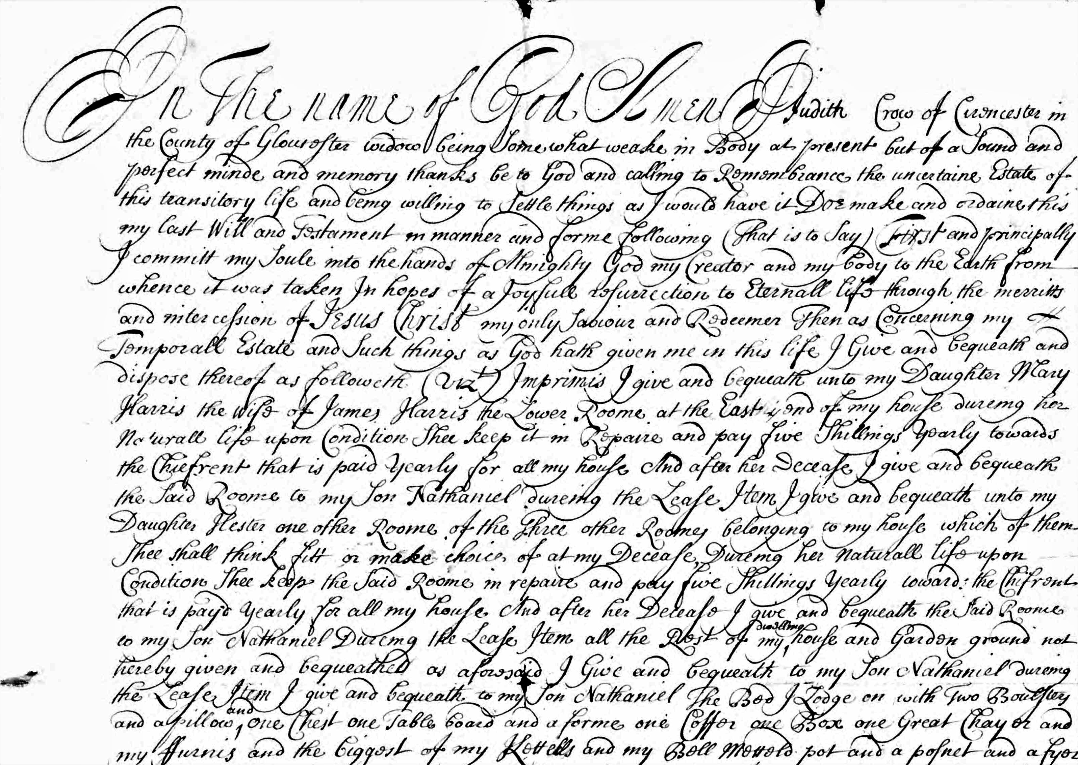
Making the most out of Gloucestershire Archives…
The Bingham Library Trust are rightly proud of its Archive. Its content and array of different material would certainly have pleased that most enthusiastic of librarians, Sidney Harrison, and would undoubtedly have pleased Daniel George Bingham too.
However, it is important to understand that the rest of the Gloucestershire Archive is also accessible to all. This vast collection, of millions of documents, does not overshadow our wonderful Bingham Archive, it enhances it.
These examples have value both as personal history and as a piece of Cirencester’s social history. They are extracts from the will and inventory of Judith Crow of Cirencester, dating 1708. Within her will she describes her Cirencester property and makes specific requests of personal items such as the biggest of my Kettells. The values of those items are subsequently recorded in her inventory.
Amongst the Bingham Library Trust Archive and all the holdings of Gloucestershire Archives, there are many stories just waiting to be uncovered.
GDR/WILLS/1798/139 and GDR/INV/1708/58

Slide 36
What’s in your attic?
If you have art or archives in your home and you’re unsure about how to care for them or what to do with them, please contact our Collections Officer, Helen Timlin, on helen.Timlin@binghamlibrarytrust.org.uk
All art and archives tell a story and are part of our heritage – photographs, private letters, diaries, deeds, records of societies, clubs and businesses, ephemera and local artwork, whether amateur sketches or master oil paintings.
We can advise you on the best way to take care for your personal collections at home and ensure they are preserved for generations to come.
Alternatively, if you have decided you would like to rehome your collections and share them with the public, we can advise on donating or depositing items to the Bingham Library Trust or to Gloucestershire Archives where they can be preserved and shared indefinitely.
.

